Slide 1
How to work with dictionaries

Slide 2
Outlines
Creating a dictionary
Retrieving a Value from a Dictionary
Adding Elements to an Existing Dictionary
Some Dictionary Methods (get, clear,..etc)
Deleting Elements From an Existing Dictionary

Slide 3
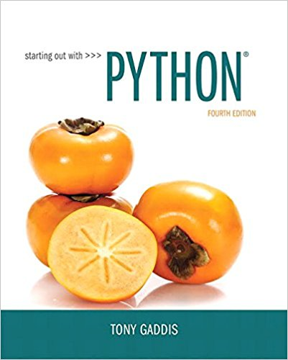
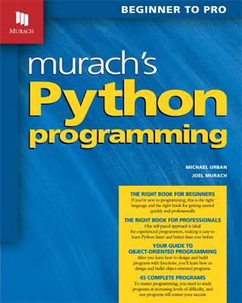
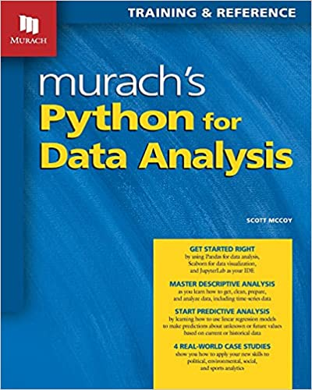
Slides are taken and adapted from:

Slide 4
Dictionaries
Dictionary: object that stores a collection of data
  Each element consists of a key and a value
    Often referred to as mapping of key to value
    Key must be an immutable object
  To retrieve a specific value, use the key associated with it
  Format for creating a dictionary
  dictionary =
  {key1:val1, key2:val2}

Slide 5
The syntax for creating a dictionary
C12, Slide <number>

Slide 6
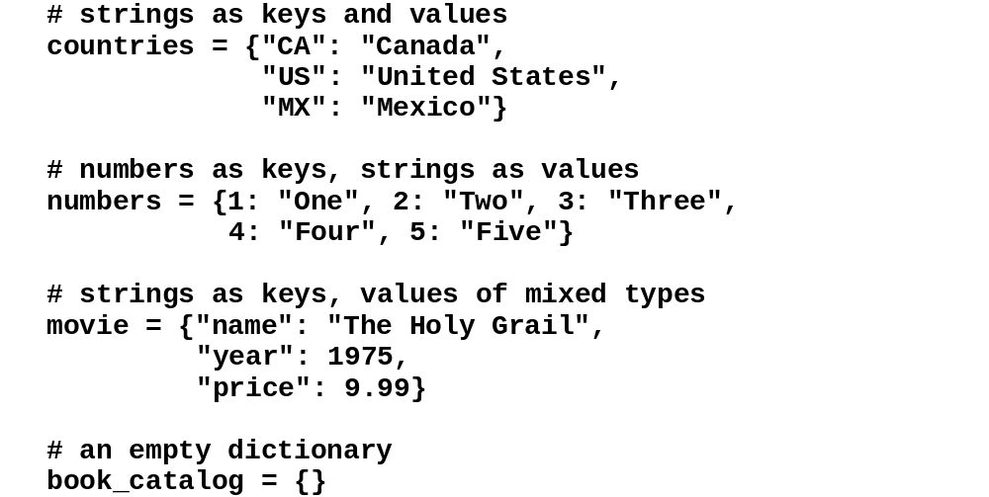
Code that creates dictionaries
C12, Slide <number>

Slide 7
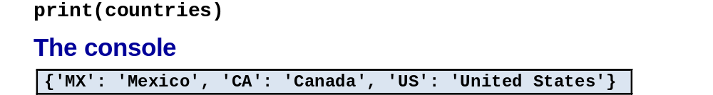
Code that prints a dictionary to the console
C12, Slide <number>

Slide 8

The countries dictionary
C12, Slide <number>

Slide 9
Retrieving a Value from a Dictionary
Elements in dictionary are unsorted
General format for retrieving value from dictionary: dictionary[key]
  If key in the dictionary, associated value is returned, otherwise, KeyError exception is raised

Slide 10
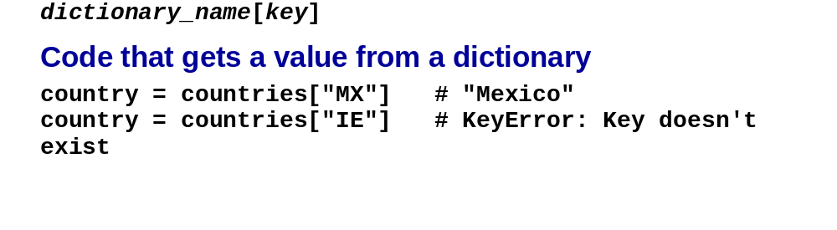
The syntax for accessing a value
C12, Slide <number>

Slide 11
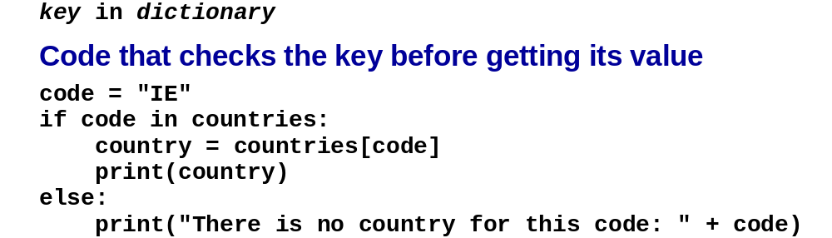
The syntax for checking if a key exists
Test whether a key is in a dictionary using the in and not in operators
  Helps prevent KeyError exceptions
C12, Slide <number>

Slide 12
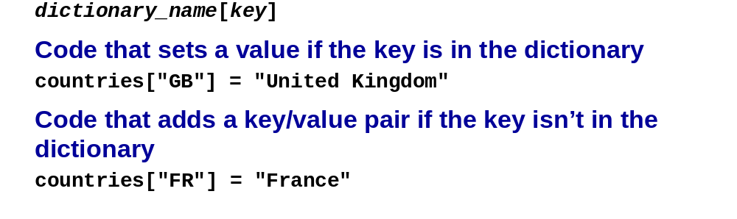
Adding Elements to an Existing Dictionary
Dictionaries are mutable objects
To add a new key-value pair:
dictionary[key] = value
If key exists in the dictionary, the value associated with it will be changed

Slide 13
Deleting Elements From an Existing Dictionary
To delete a key-value pair:
del dictionary[key]
  If key is not in the dictionary, KeyError exception is raised

Slide 14
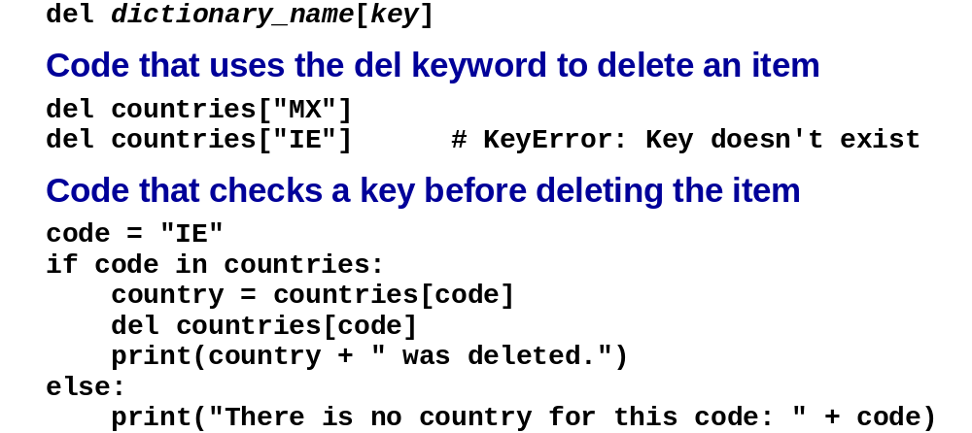
The syntax for deleting an item
C12, Slide <number>

Slide 15
Getting the Number of Elements and Mixing Data Types
len function: used to obtain number of elements in a dictionary
Keys must be immutable objects, but associated values can be any type of object
  One dictionary can include keys of several different immutable types
Values stored in a single dictionary can be of different types

Slide 16
Some Dictionary Methods
clear method: deletes all the elements in a dictionary, leaving it empty
  Format: dictionary.clear()
get method: gets a value associated with specified key from the dictionary
  Format: dictionary.get(key, default)
    default is returned if key is not found
  Alternative to [] operator
    Cannot raise KeyError exception

Slide 17
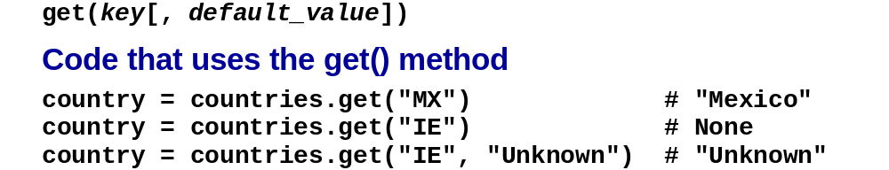
The get()method of a dictionary object
C12, Slide <number>

Slide 18
Some Dictionary Methods (cont’d.)
items method: returns all the dictionaries keys and associated values
  Format: dictionary.items()
  Returned as a dictionary view
    Use a for loop to iterate over the tuples in the sequence
      Can use a variable which receives a tuple, or can use two variables which receive key and value

Slide 19
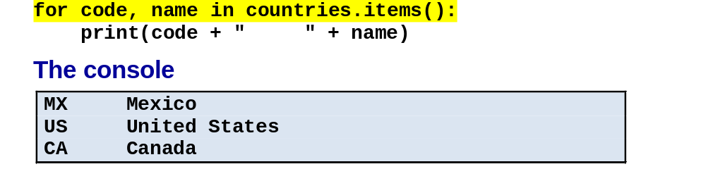
Code that unpacks a tuple as it loops through all keys and values
C12, Slide <number>

Slide 20
Some Dictionary Methods (cont’d.)
keys method: returns all the dictionaries keys as a sequence
  Format: dictionary.keys()
for key in dictionary.keys():
print(key)

Slide 21
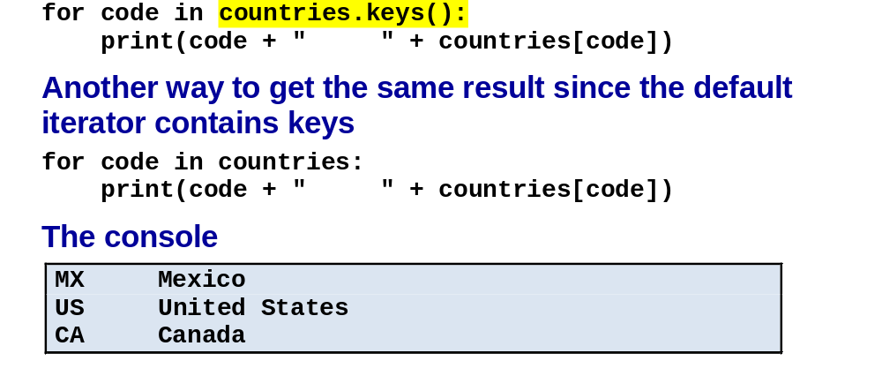
Code that loops through all keys and values
C12, Slide <number>

Slide 22
Some Dictionary Methods (cont’d.)
values method: returns all the dictionaries values as a sequence
  Format: dictionary.values()
  Use a for loop to iterate over the values
for value in dictionary.values():
print(value)

Slide 23
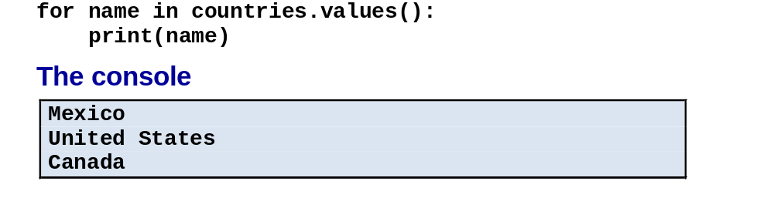
Code that loops through all values
C12, Slide <number>

Slide 24
Some Dictionary Methods (cont’d.)
pop method: returns value associated with specified key and removes that key-value pair from the dictionary
  Format:
  value = dictionary.pop(key, ‘Error MSG’)
    Error MSG is returned if key is not found

Slide 25
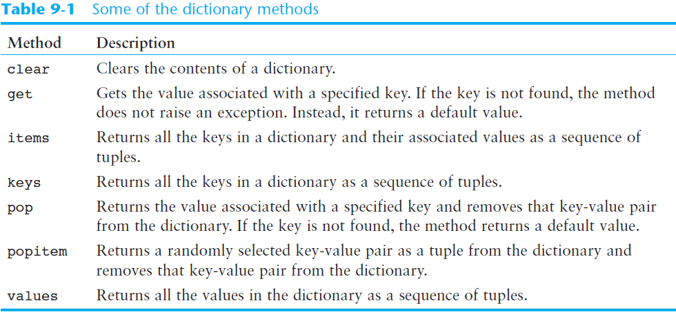
Some Dictionary Methods (cont’d.)

Slide 26
Built-in constructors for creating dictionaries and lists
C12, Slide <number>

Slide 27
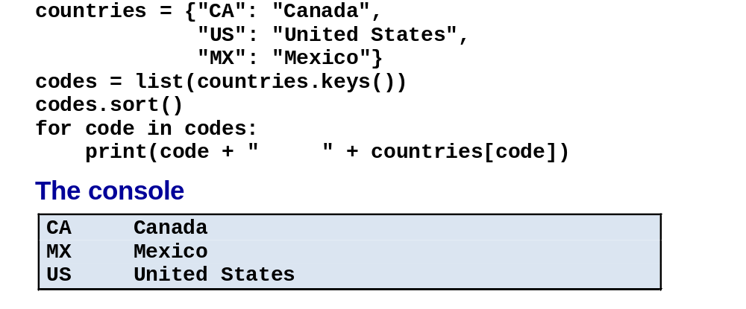
Code that converts the keys of a dictionary to a list and sorts them
C12, Slide <number>

Slide 28
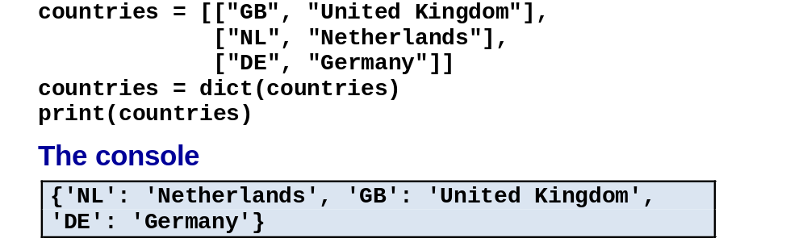
Code that converts a two-dimensional list to a dictionary
C12, Slide <number>

Slide 29
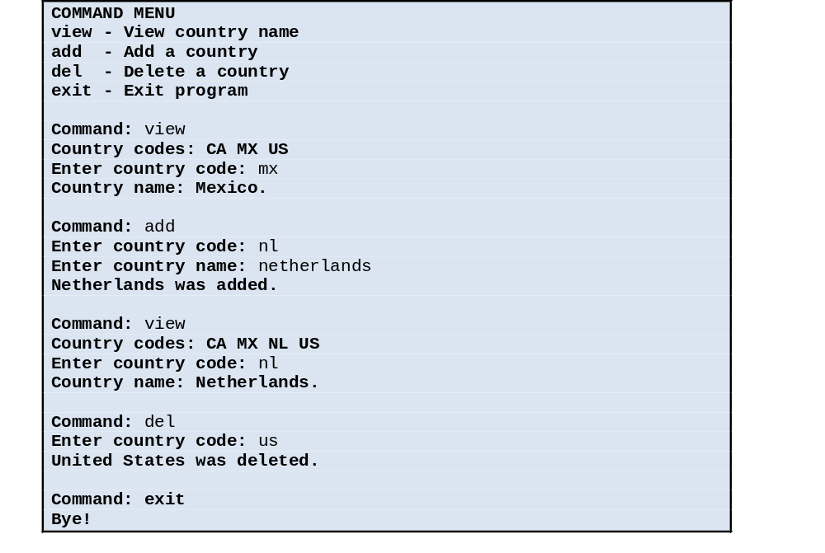
The user interface for the Country program
C12, Slide <number>

Slide 30
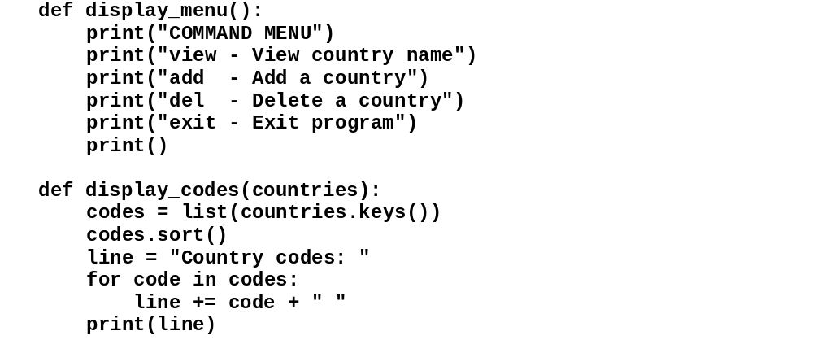
The code
C12, Slide <number>

Slide 31
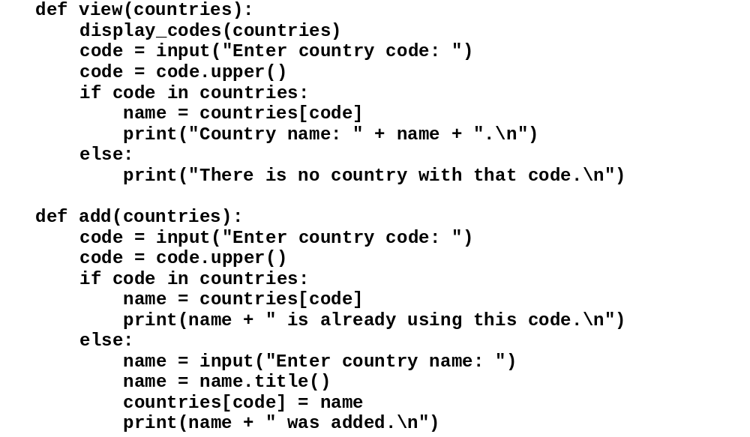
The code (cont.)
C12, Slide <number>

Slide 32
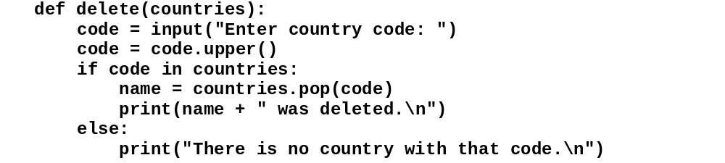
The code (cont.)
C12, Slide <number>

Slide 33
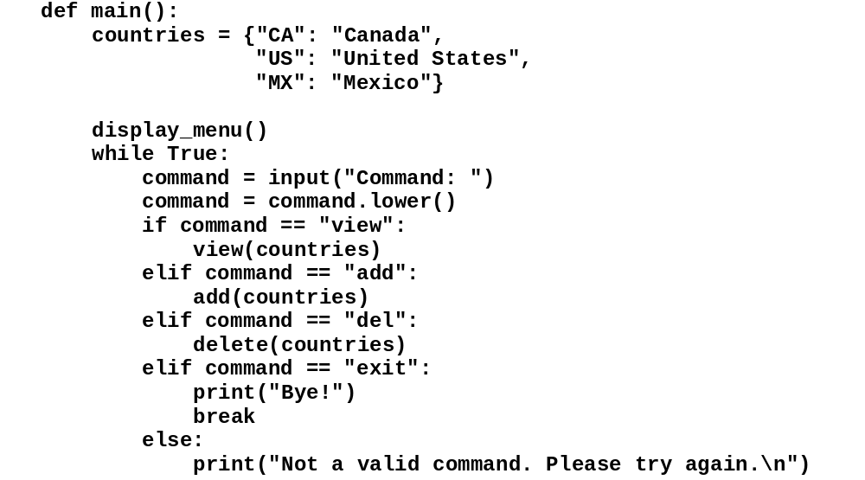
The code (cont.)
C12, Slide <number>

Slide 34
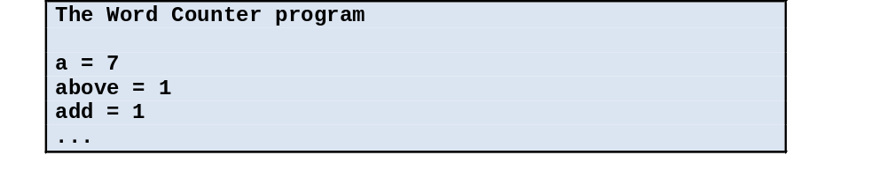
The user interface for the Word Counter program
C12, Slide <number>

Slide 35
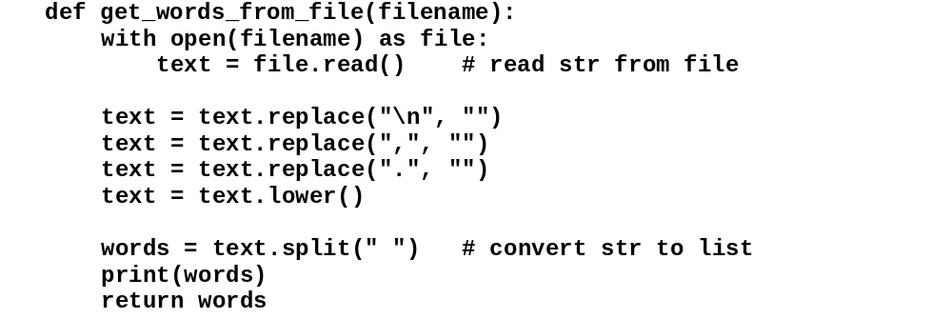
The code
C12, Slide <number>

Slide 36
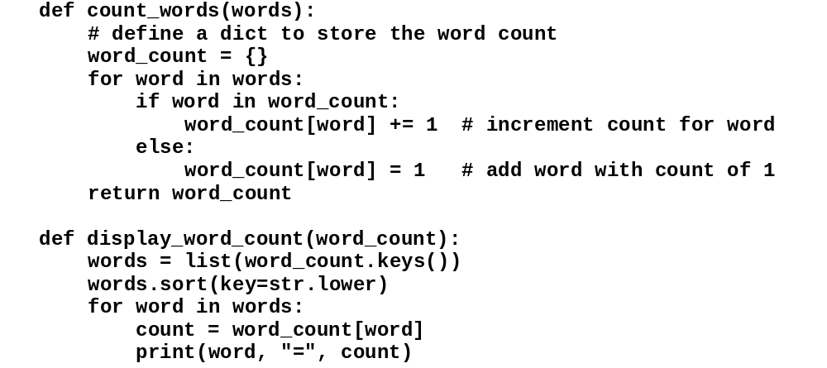
The code (cont.)
C12, Slide <number>

Slide 37
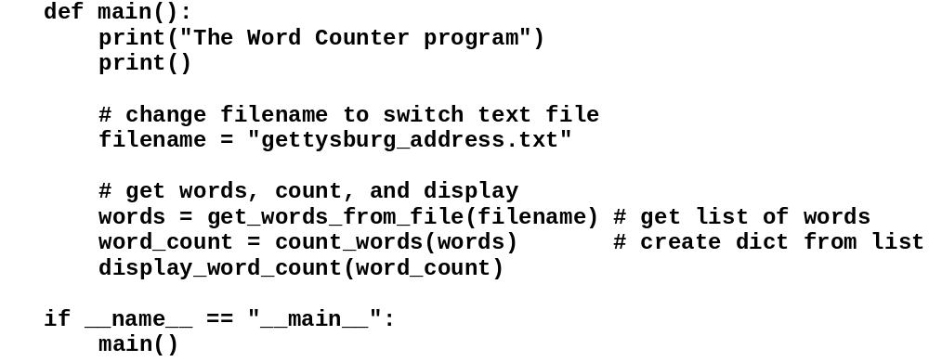
The code (cont.)
C12, Slide <number>

Slide 38
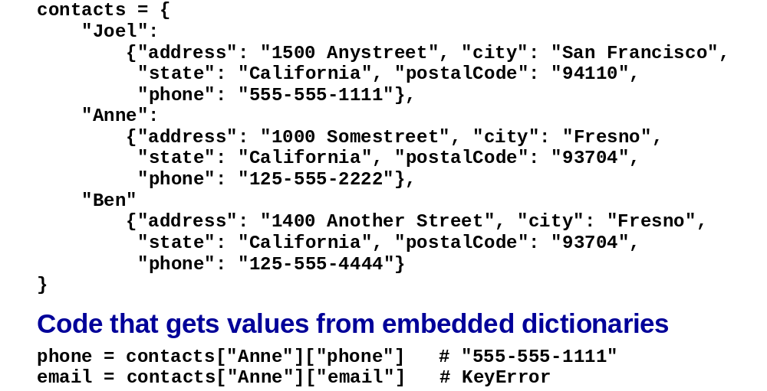
A dictionary that contains other dictionaries as values
C12, Slide <number>

Slide 39
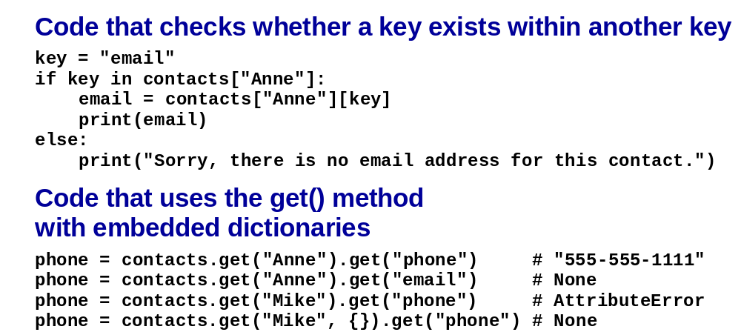
A dictionary that contains other dictionaries as values (cont.)
C12, Slide <number>

Slide 40
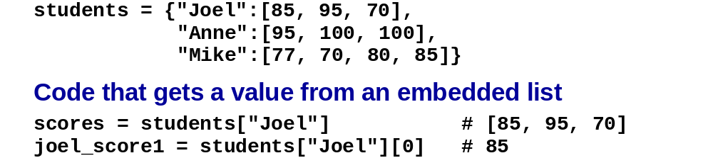
A dictionary that contains lists as values
C12, Slide <number>

Slide 41
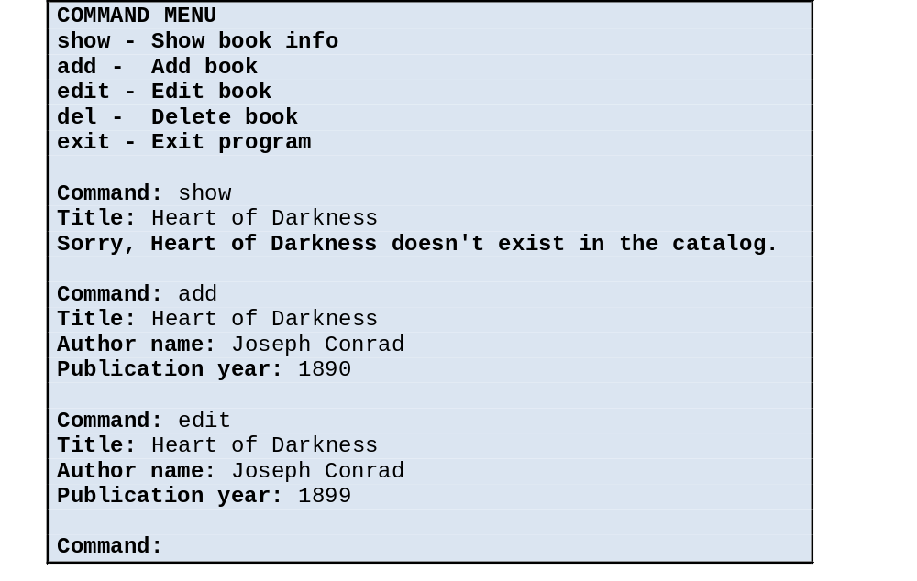
The user interface for the Book Catalog program
C12, Slide <number>

Slide 42
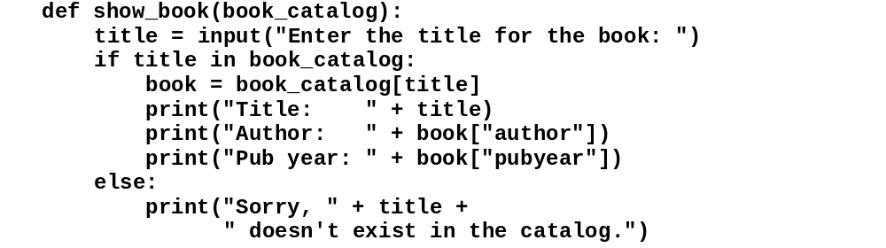
The code
C12, Slide <number>

Slide 43
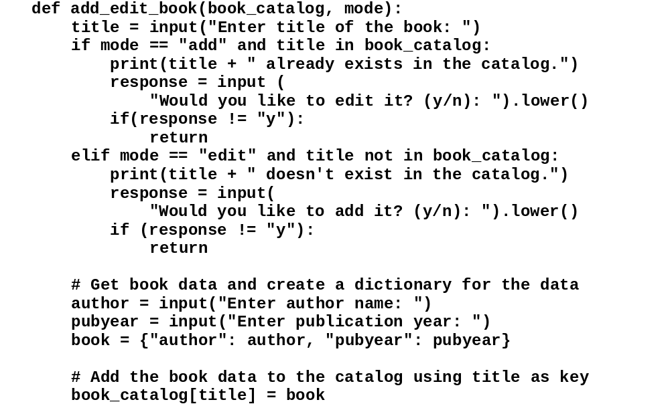
The code (cont.)
C12, Slide <number>

Slide 44
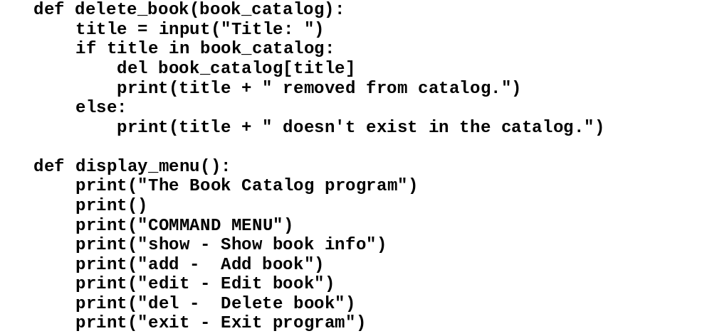
The code (cont.)
C12, Slide <number>

Slide 45
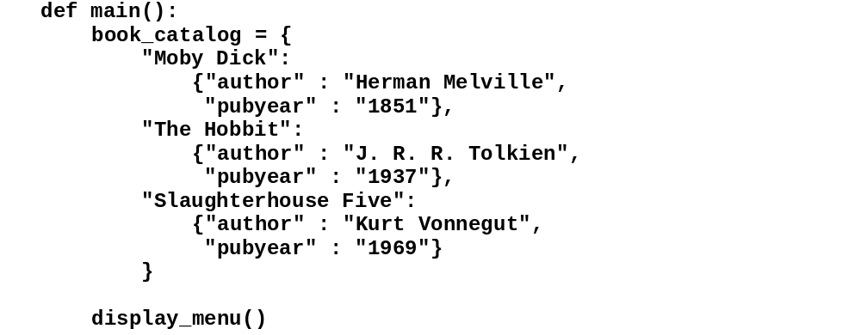
The code (cont.)
C12, Slide <number>

Slide 46
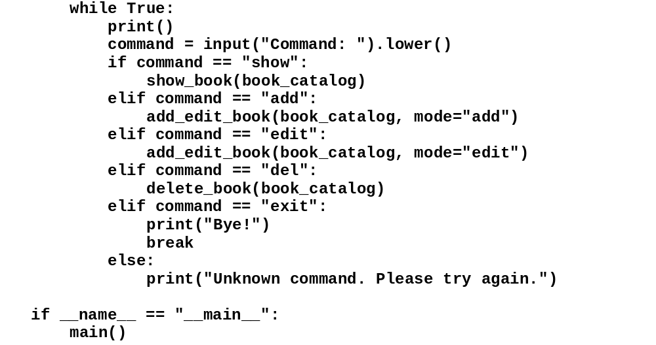
The code (cont.)
C12, Slide <number>

Slide 47
Json file
contacts = {
"Joel":
{"address": "1500 Anystreet", "city": "San Francisco",
"state": "California", "postalCode": "94110",
"phone": "555-555-1111"},
"Anne":
{"address": "1000 Somestreet", "city": "Fresno",
"state": "California", "postalCode": "93704",
"phone": "125-555-2222"},
"Ben":
{"address": "1400 Another Street", "city": "Fresno",
"state": "California", "postalCode": "93704",
"phone": "125-555-4444"}
}
import json
s=json.dumps(contacts) #dump as a string into a json format
print(s)
print(type(s))

Slide 48
with open(r'E:\contacts.txt','w') as f:
f.write(s)
f=open(r'E:\contacts.txt','r')
s=f.read()
S
contacts_=json.loads(s)
contacts_
contacts_["Joel"]
for person in contacts_:
print(contacts_[person])
city = contacts_["Joel"]["city"] # "San Francisco"

